Slide 1






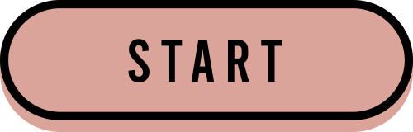

Vocabulary Study System
DC127368 Huang Chuyue
DC126769 Song Xueqing
Group 12

Slide 2

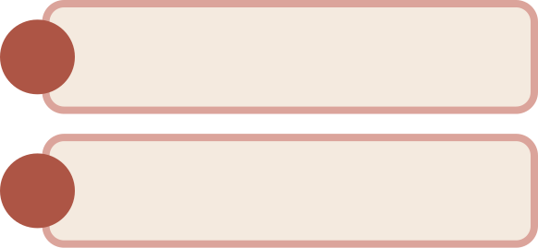

Contents
Introduction
Recommendation System
Implementation
Future plans

Slide 3




Background
Our goal is to help students confidently navigate daily life during their overseas studies by providing learning resources focused on high-frequency conversations and language usage.
We are committed to designing a learning platform that enables students to communicate fluently in common scenarios.
Notes:
After studying abroad, many Chinese students find that they are not quite proficient in using some scene vocabulary in some daily life scenarios. In order to help them quickly adapt to study abroad life and improve their speaking level, we have designed this learning website.

Slide 4
Datasets
Academic Research Scenarios
Accommodation Scenarios
Banking Service Scenarios
New Student Enrollment Scenarios
Extracurricular Scenarios
Outing Scenarios
Learning Scenarios
Library Scenarios
Notes:
Then we find some vocabulary datasets from the Internet.It contains 8 big scenarios which are…..
Each big scenarios includes 2-4 small scenarios which are more specific.
Total are 23 scenarios

Slide 5

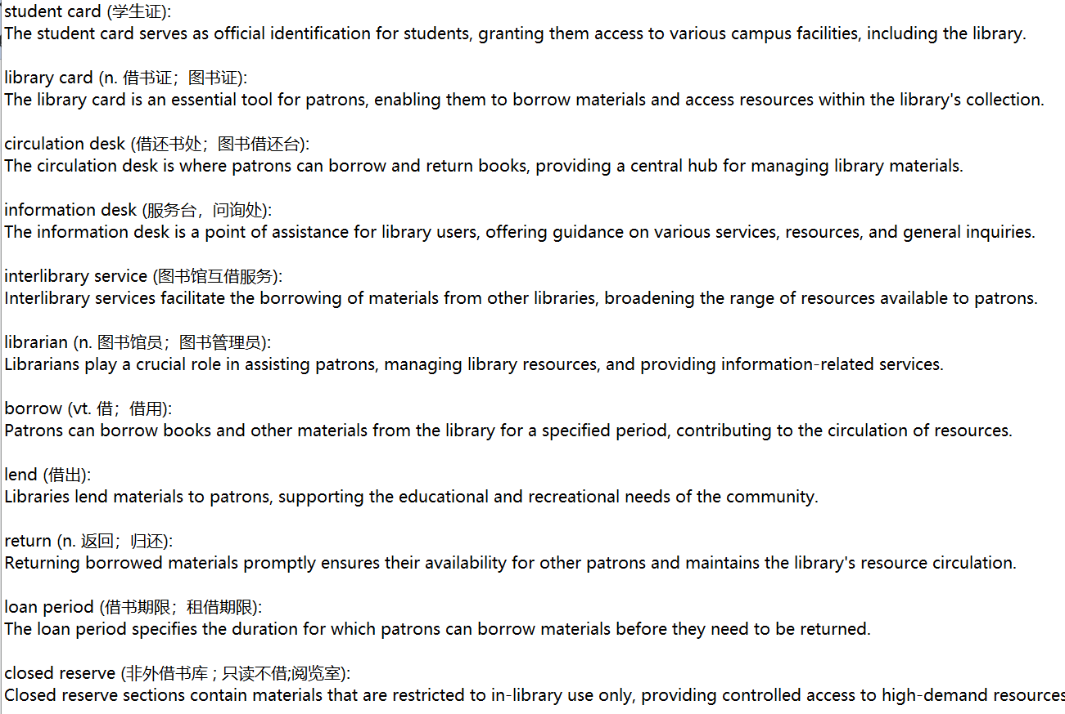

Dataset(example)
one word / phrase
Chinese meaning
example sentence
Notes:
The example sentence can make usesr understand and use vocabulary faster.

Slide 6





Recommendation System

Slide 7
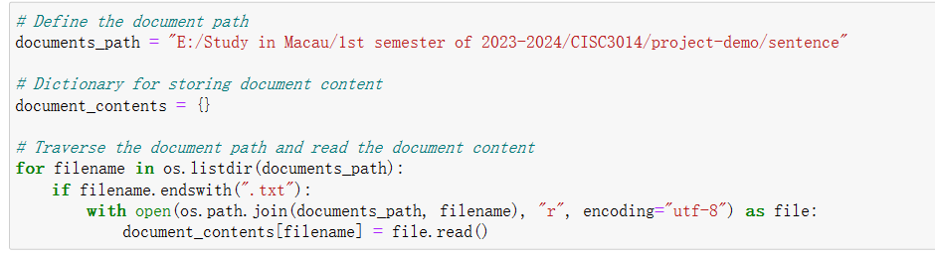
Process - reading text

Slide 8
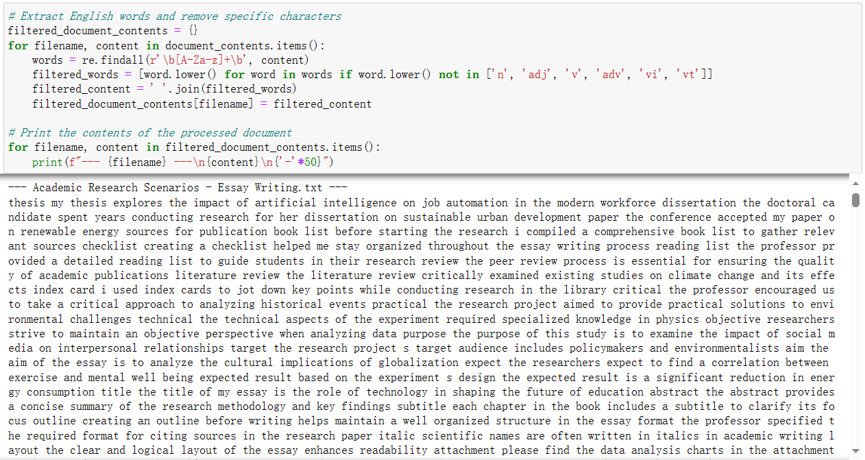
Process - tokenization
Notes:
Extract English words and remove specific characters like part of speech.

Slide 9
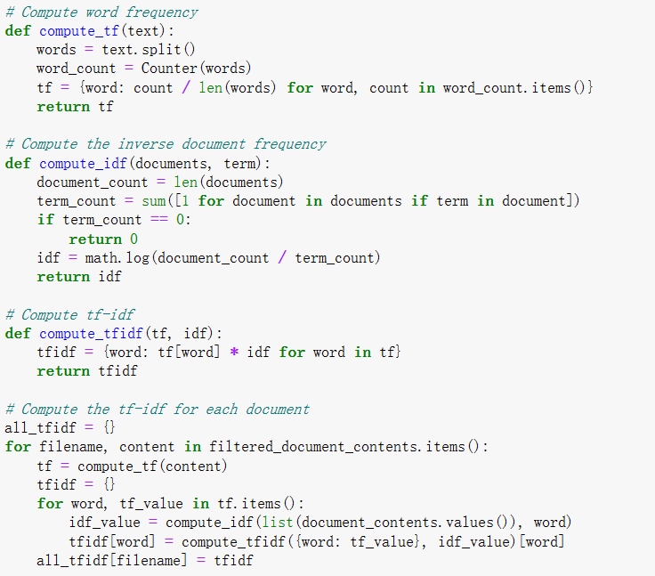
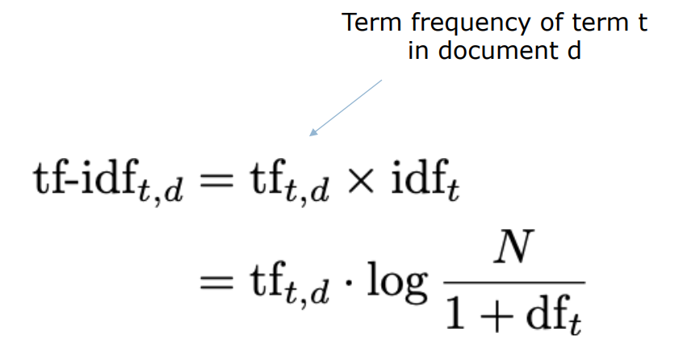
Process - compute tf-idf

Slide 10
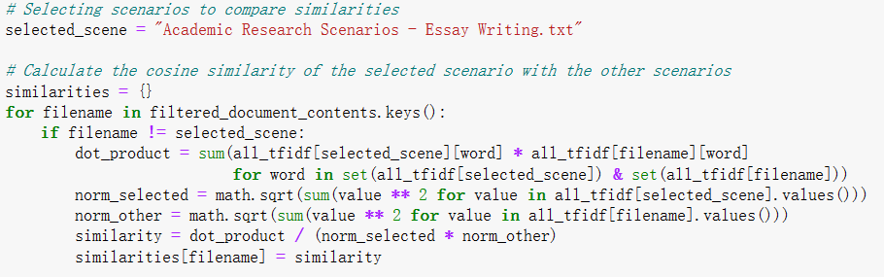
Process - calculate cosine similarity

Slide 11
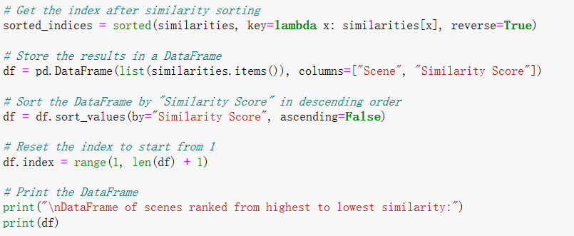
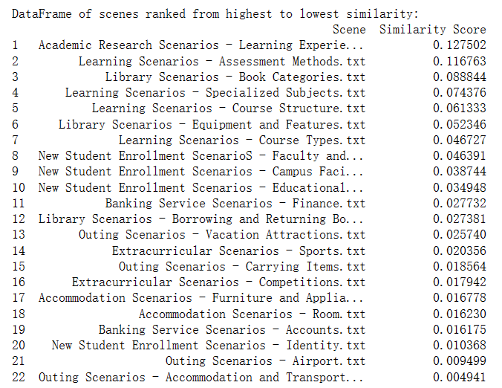
Process - ranking
Notes:
we can recommend relative scenarios based on the user’s score and this ranking.

Slide 12





Implementation
html+css+js
web design
dataset(.json)
similarity matrix(.xlsx)
python
algorithm
Frontend
api
Files
Notes:
Now I am going to introduce our implementation of our vocab study system. We implemented the website, using basic web development programming languages with some web design knowledge, and using python apis to extract dataset and similarity files together with a short algorithm that I will mention later.

Slide 13
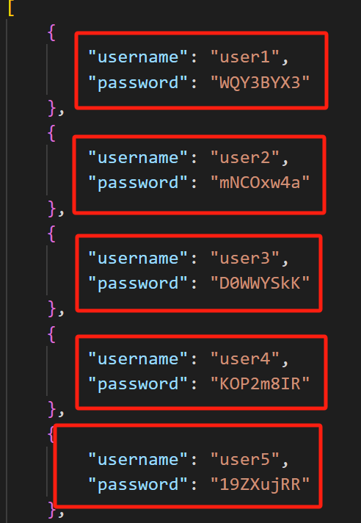
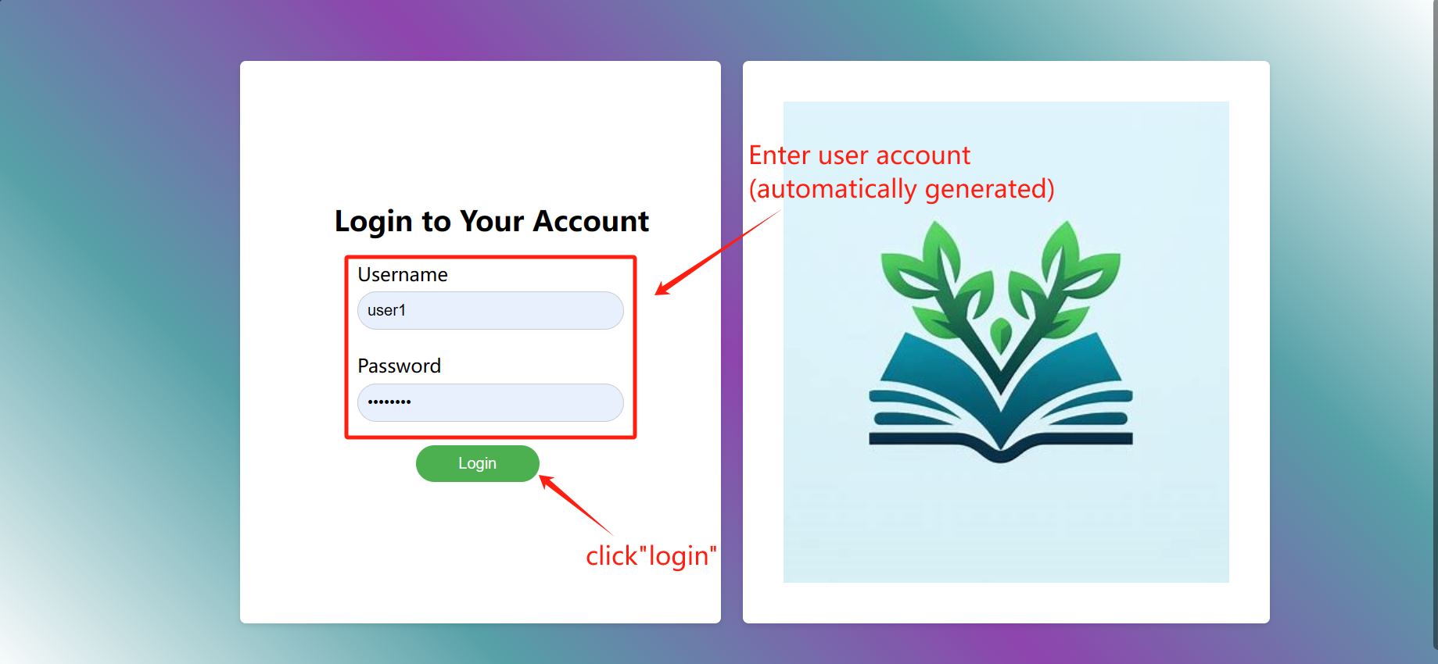
User Interface
Step 1: Log in
Notes:
Now let’s introduce the workflow of our website. First, we generated some user accounts for users tolog in to our system.

Slide 14
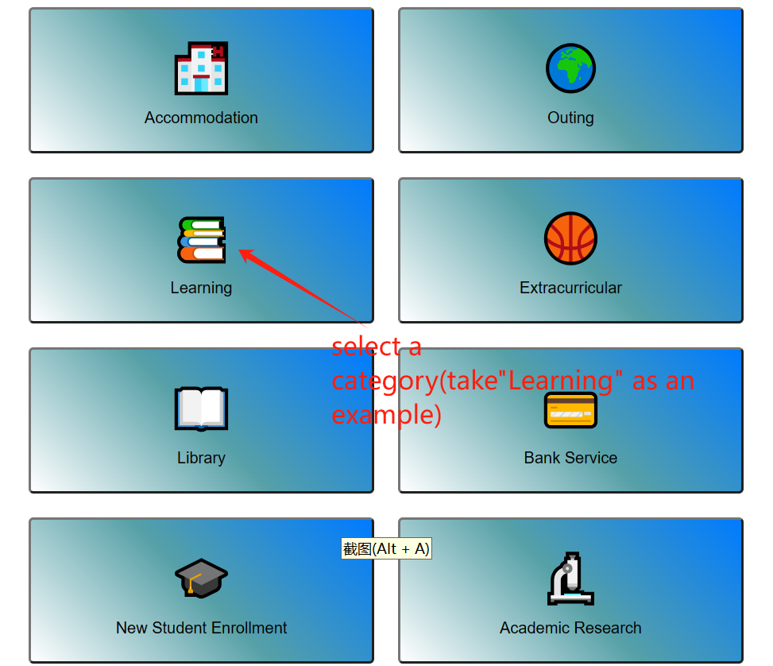
User Interface
Step 2:
Select a category
Notes:
After log in, users can see the categories display on the webpage, and select one that is most interested.

Slide 15
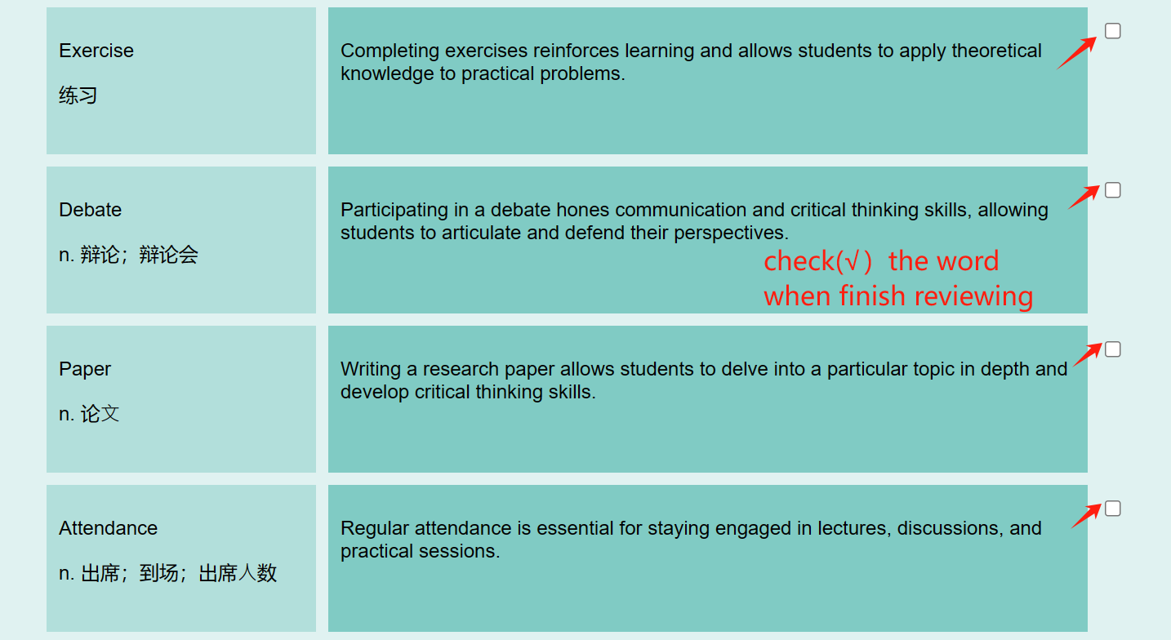
User Interface
Step 3:
Start the learning journey
1st round: random words from the category
2nd and after: recommend based on rating
Notes:
Now the learning journey has started. Try to grab some words and new context. When you feel satisfied, click the checkbox on the right side. There are 10 words in one list.
during the first round, we get random words from the category chosen; from 2nd to after, we get words based on recommendation.

Slide 16
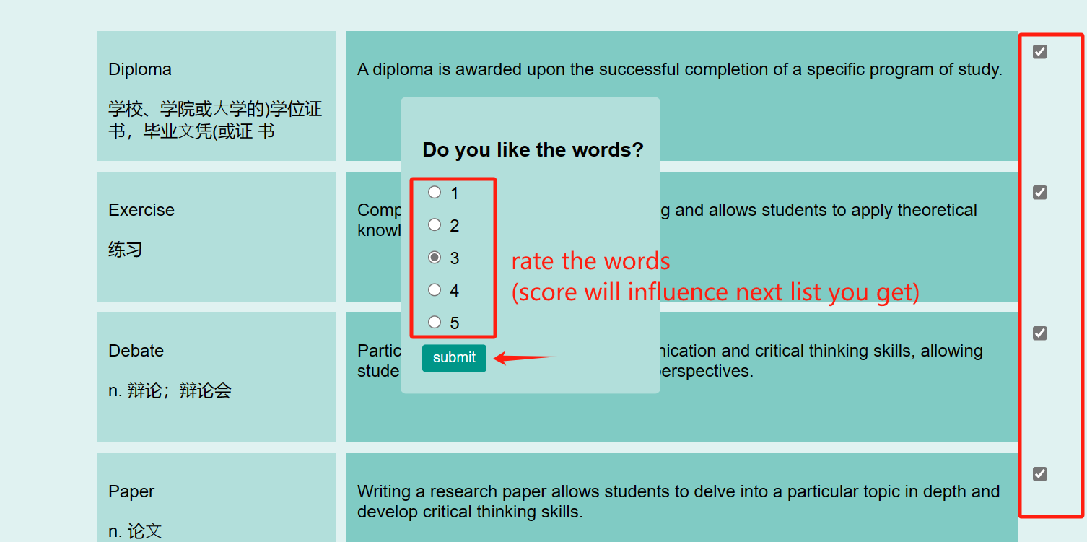
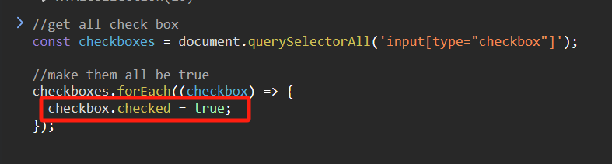
User Interface
Step 3:
Start the learning journey
(for testing convenience)
Notes:
The rating table only pops out when all 10 words are checked.
As clicking checkbox one by one is time consuming during testing, we used this code snippet to automatically click them to save time.

Slide 17
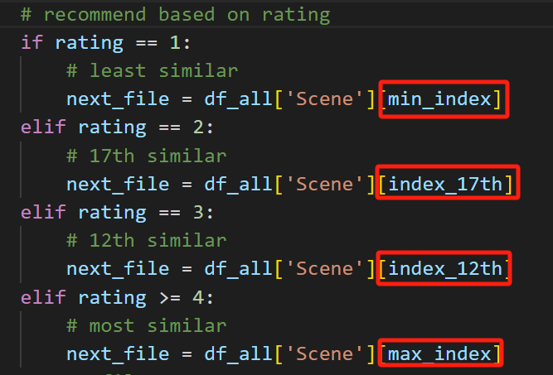
User Interface
Step 3:
core idea:
recommendation based
on rating
Notes:
The most special part of our system is to recommend new words based on rating.
That when user choose 4 or 5, they will get the most similar file in the next list; choosing three they get 12th similar(in the middle); choosing 2 get 17th and choosing 1 get the least similar.

Slide 18
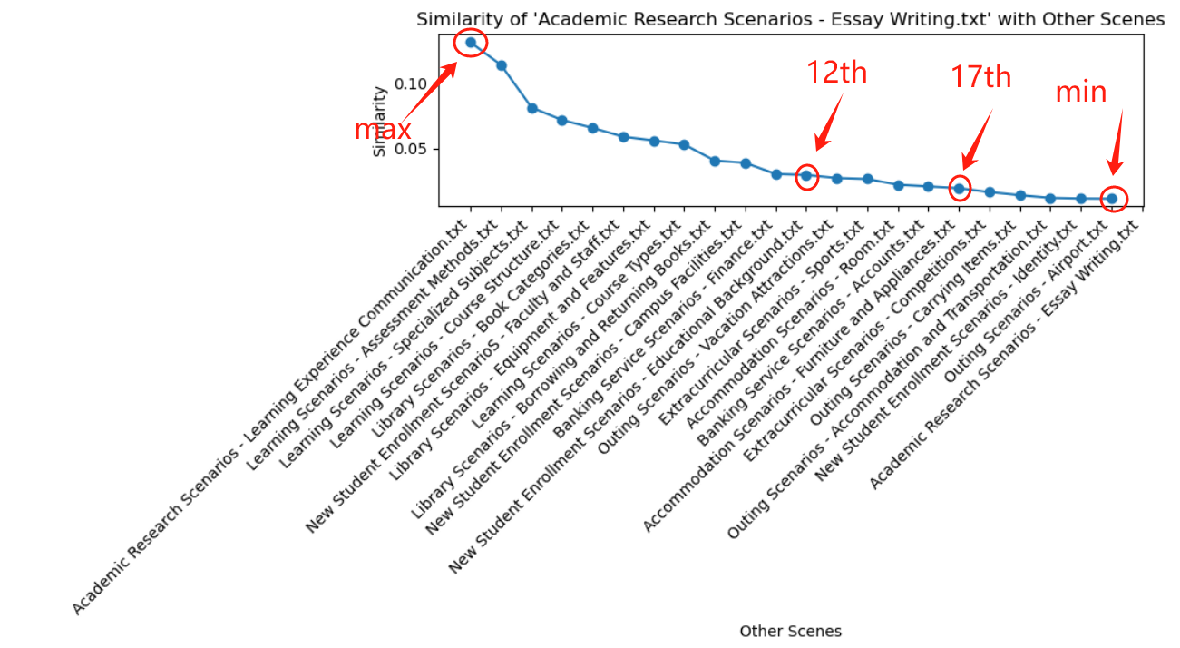
User Interface
Notes:
The reason why we choose these points to combine with ratings are based on the similarity plot, we sorted them in descending order and picked out the four points that are most representative and well separated. Since a lot of people have the habit to choose either 4 or 5 to represent satisfaction, we combined the two cases together.

Slide 19
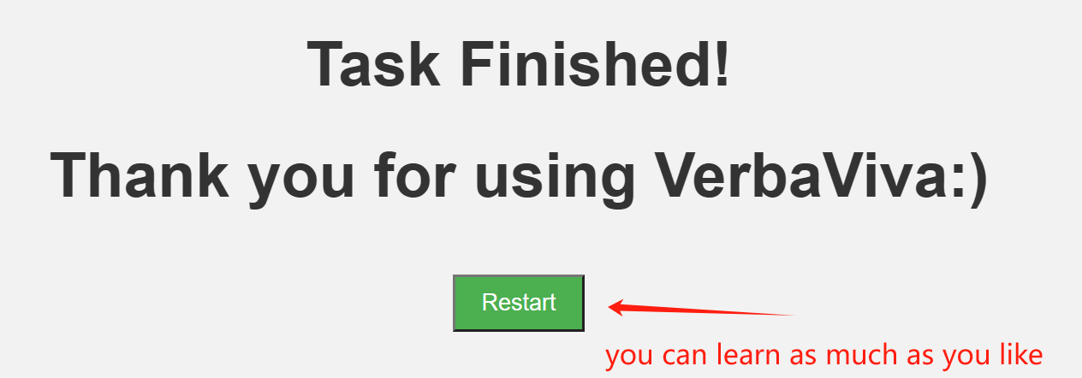
User Interface
Final step:
you can learn as much as you like
Notes:
This is the last page of our website, but also a new start. If you think you still want more, you can learn as much as you like.

Slide 20
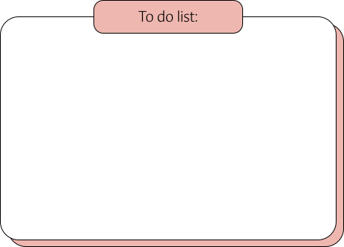
Future Plans
Test
Analysis
We're going to find 30 users to test the website with.
Users will go through 4 rounds of the word list.
Each round of learning is scored by the user at the end of the round.
Aggregate the scores of all users.
Analyze the scoring data to see if it matches our expectations.
We are expecting the users score 4-5
in the final round.
Notes:
We still have some plan in the future, that we're going to invite 30 users to test the website.
Each user will go through 4 rounds of the word list.
Each round of learning is scored by the user at the end of the round.
As different user have different preference, we don’t expect high ratings in the beginning, but gain some satisfaction incrementally.
We will display the final result in our report,please look forward to it.

Slide 21


Question Time

Slide 22







